Slide 1
Differentiation
MAHRUKH KHAN
COMPUTER SCIENCE AND ELECTRICAL ENGINEERING
UNIVERSITY OF MISSOURI ,KANSAS CITY

Slide 2
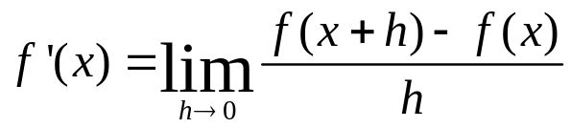
Numerical Differentiation
The mathematical definition:
Can also be thought of as the tangent line.
x-h
x
x+h

Slide 3
Numerical Differentiation
We can not calculate the limit as h goes to zero, so we need to approximate it.
Apply directly for a non-zero h leads to the slope of the secant curve.
x-h
x
x+h

Slide 4
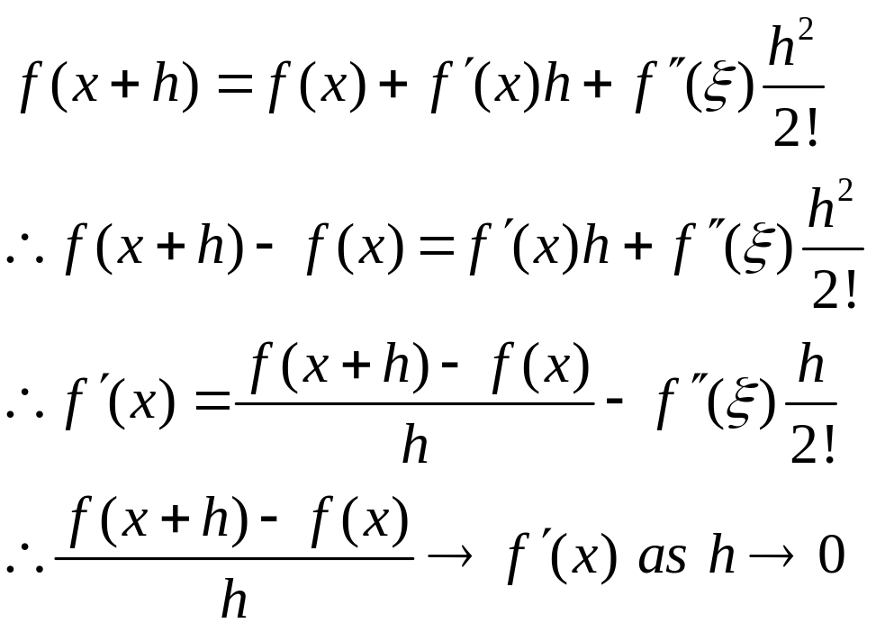
Numerical Differentiation
This is called Forward Differences and can be derived using Taylor’s Series:
Theoretically speaking

Slide 5
Truncation Errors
Let f(x) = a+e, and f(x+h) = a+f.
Then, as h approaches zero, e<<a and f<<a.
With limited precision on our computer, our representation of f(x) ≈ a ≈ f(x+h).
We can easily get a random round-off bit as the most significant digit in the subtraction.
Dividing by h, leads to a very wrong answer for f’(x).

Slide 6
Error Tradeoff
Using a smaller step size reduces truncation error.
However, it increases the round-off error.
Trade off/diminishing returns occurs: Always think and test!
Point of
diminishing
returns
Total error
Log error
Round off error
Truncation error
Log step size

Slide 7
Numerical Differentiation
This formula favors (or biases towards) the right-hand side of the curve.
Why not use the left?
x-h
x
x+h

Slide 8
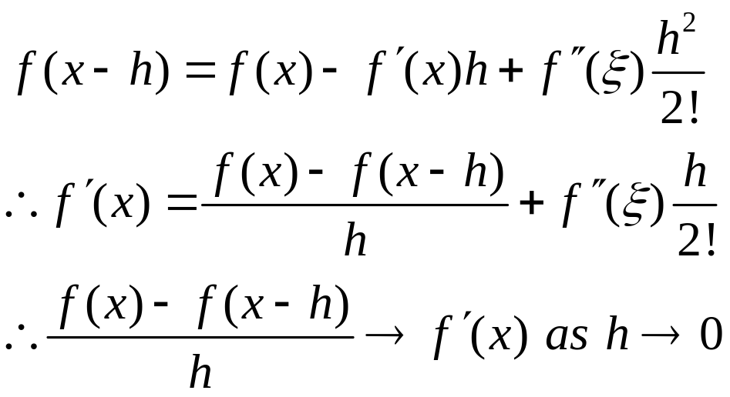
Numerical Differentiation
This leads to the Backward Differences formula.

Slide 9
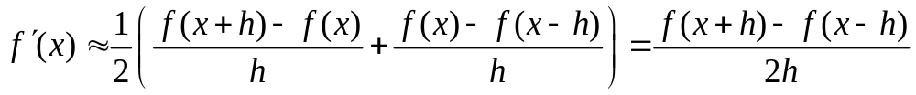
Numerical Differentiation
Can we do better?
Let’s average the two:
This is called the Central Difference formula.
Forward difference Backward difference

Slide 10
Central Differences
This formula does not seem very good.
  It does not follow the calculus formula.
  It takes the slope of the secant with width 2h.
  The actual point we are interested in is not even evaluated.
x-h
x
x+h

Slide 11
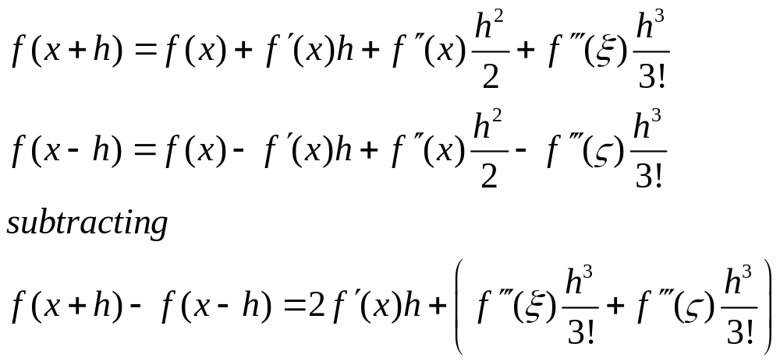
Numerical Differentiation
Is this any better?
Let’s use Taylor’s Series to examine the error:

Slide 12
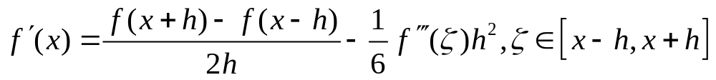
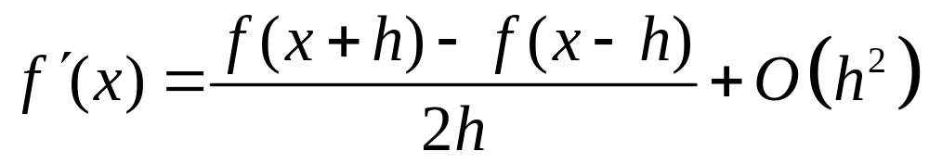
Central Differences
The central differences formula has much better convergence.
Approaches the derivative as h² goes to zero!!

Slide 13
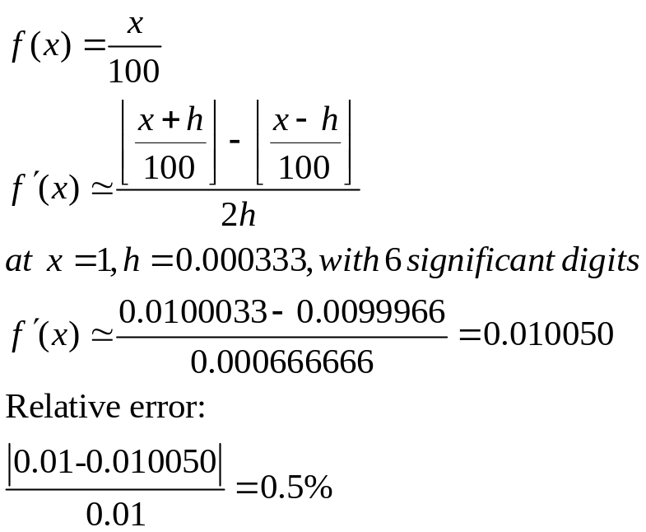
Warning
Still have truncation error problem.
Consider the case of:
Build a table with
smaller values of h.
What about large
values of h for this
function?

Slide 14
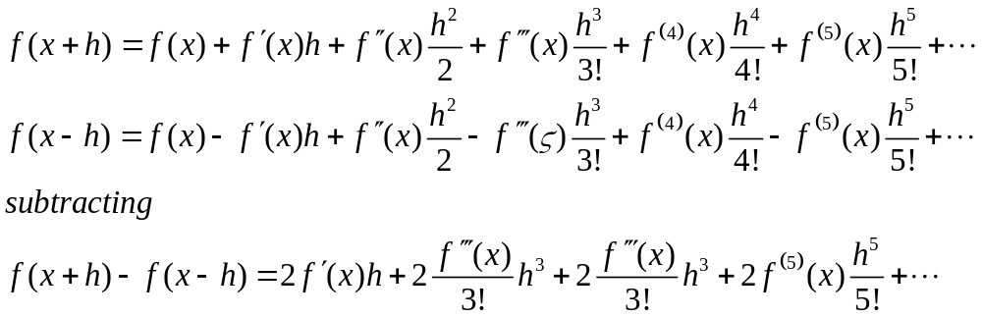
Richardson Extrapolation
Can we do better?
Is my choice of h a good one?
Let’s subtract the two Taylor Series expansions again:

Slide 15
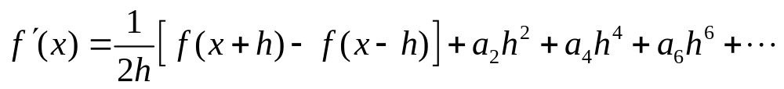
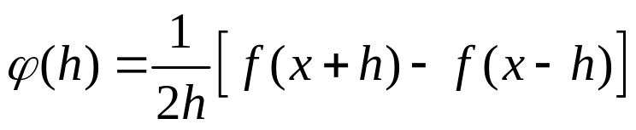
Richardson Extrapolation
Assuming the higher derivatives exist, we can hold x fixed (which also fixes the values of f(x)), to obtain the following formula.
Richardson Extrapolation examines the operator below as a function of h.

Slide 16
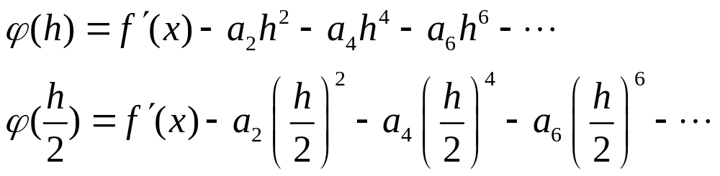
Richardson Extrapolation
This function approximates f’(x) to O(h²) as we saw earlier.
Let’s look at the operator as h goes to zero.
Same leading constants

Slide 17
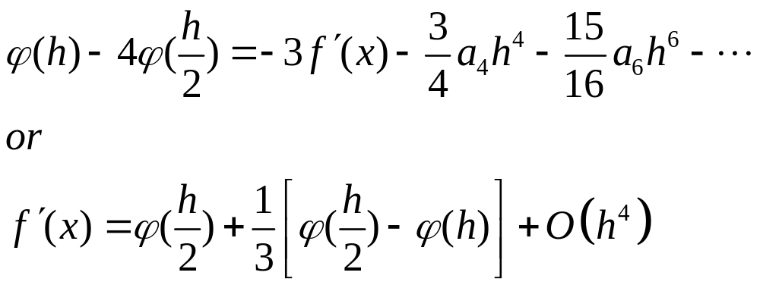
Richardson Extrapolation
Using these two formula’s, we can come up with another estimate for the derivative that cancels out the h² terms.
Extrapolates by assuming the new estimate undershot.
new estimate
difference between old
and new estimates

Slide 18
Richardson Extrapolation
If h is small (h<<1), then h⁴ goes to zero much faster than h².
Cool!!!
Can we cancel out the h⁶ term?
  Yes, by using h/4 to estimate the derivative.

Slide 19
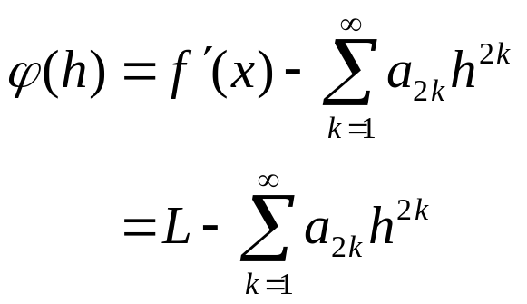
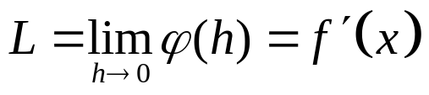
Richardson Extrapolation
Consider the following property:
where L is unknown,
as are the coefficients, a_{2k}.

Slide 20
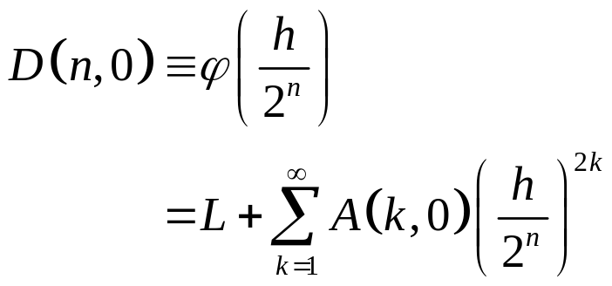
Richardson Extrapolation
Do not forget the formal definition is simply the central-differences formula:
New symbology (is this a word?):
From previous slide

Slide 21
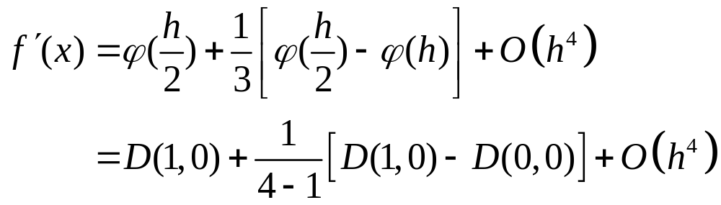
Richardson Extrapolation
D(n,0) is just the central differences operator for different values of h.
Okay, so we proceed by computing D(n,0) for several values of n.
Recalling our cancellation of the h² term.

Slide 22
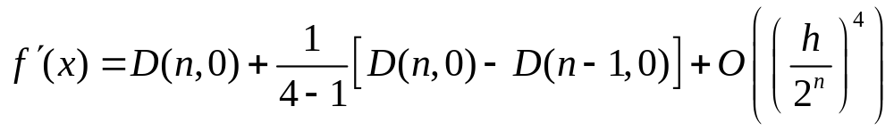
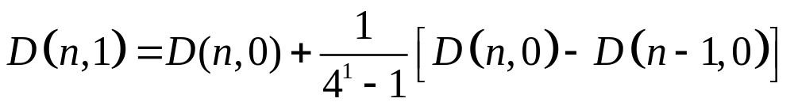
Richardson Extrapolation
If we let h→h/2, then in general, we can write:
Let’s denote this operator as:

Slide 23
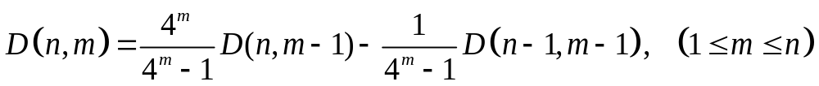
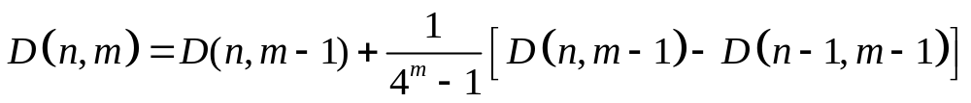
Richardson Extrapolation
Now, we can formally define Richardson’s extrapolation operator as:
or
new estimate
old estimate

Slide 24
Richardson Extrapolation
Now, we can formally define Richardson’s extrapolation operator as:
Memorize me!!!!

Slide 25
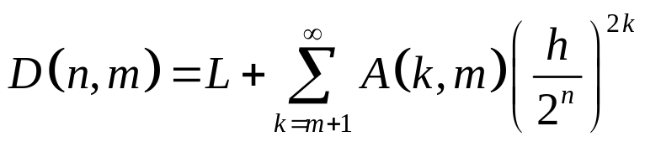
Richardson Extrapolation Theorem
These terms approach f’(x) very quickly.
Order starts much higher!!!!

Slide 26
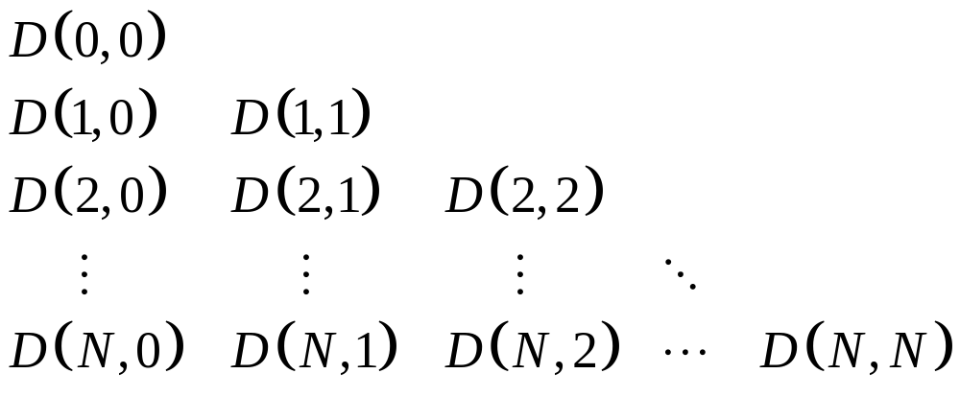
Richardson Extrapolation
Since m≤ n, this leads to a two-dimensional triangular array of values as follows:
We must pick an initial value of h and a max iteration value N.

Slide 27
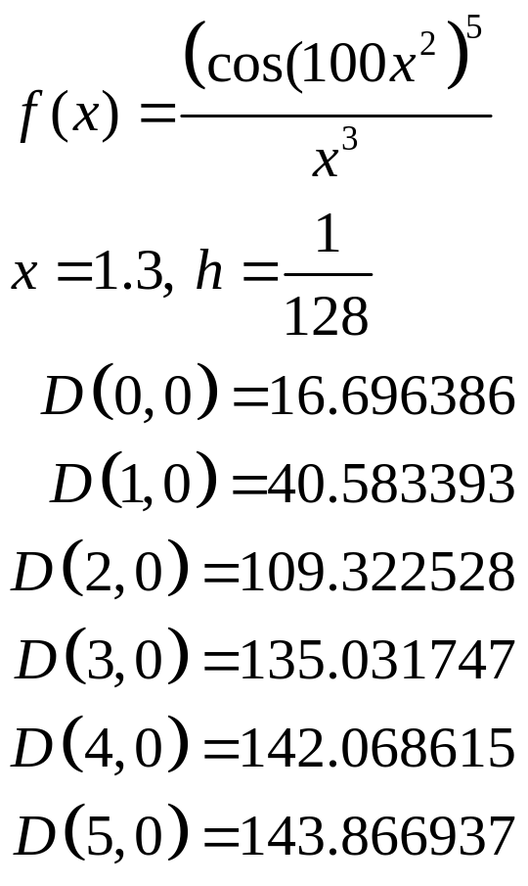
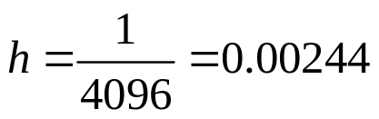
Example

Slide 28
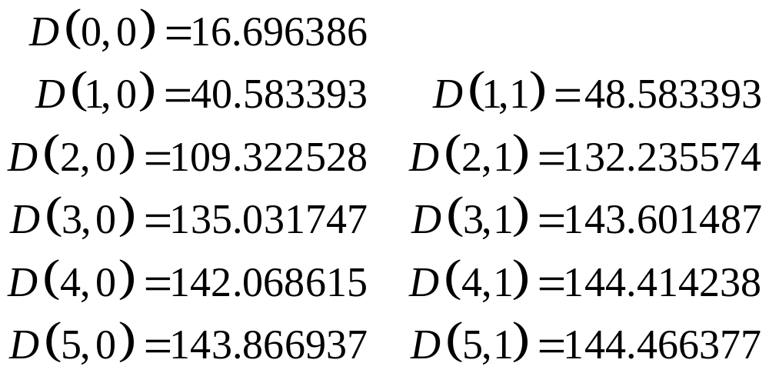
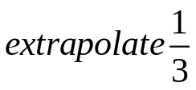
Example

Slide 29
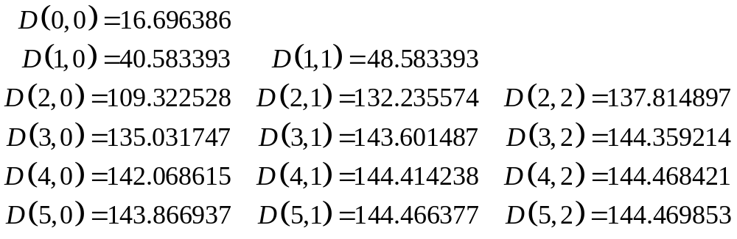
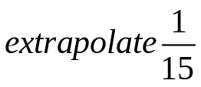
Example

Slide 30
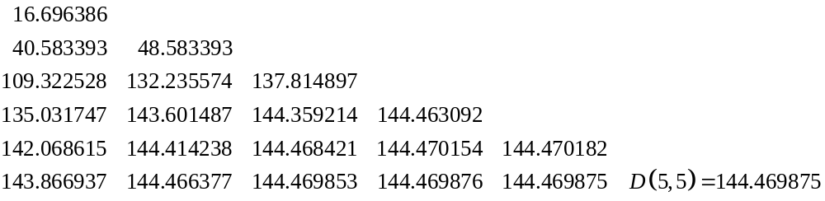



Example
Which converges up to eight decimal places.
Is it accurate?

Slide 31
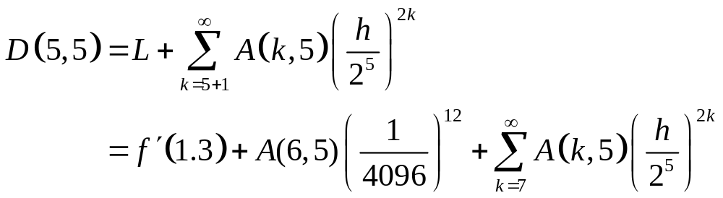

Example
We can look at the (theoretical) error term on this example.
Taking the derivative:
2⁻¹⁴⁴
Round-off error

Slide 32
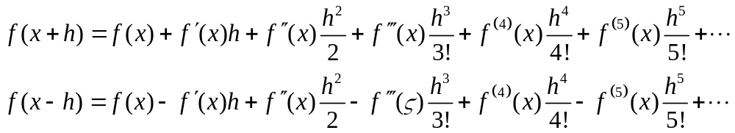
Second Derivatives
What if we need the second derivative?
Any guesses?

Slide 33
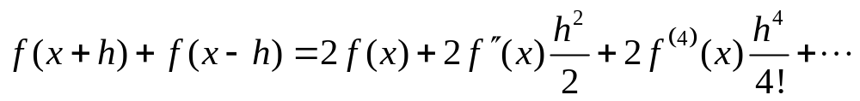
Second Derivatives
Let’s cancel out the odd derivatives and double up the even ones:
  Implies adding the terms together.

Slide 34
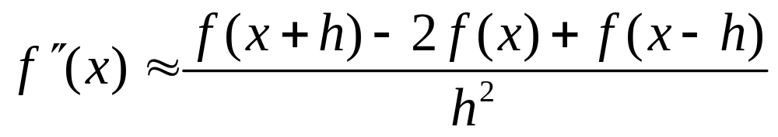
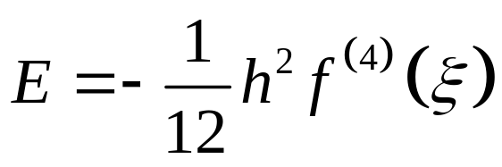
Second Derivatives
Isolating the second derivative term yields:
With an error term of:

Slide 35
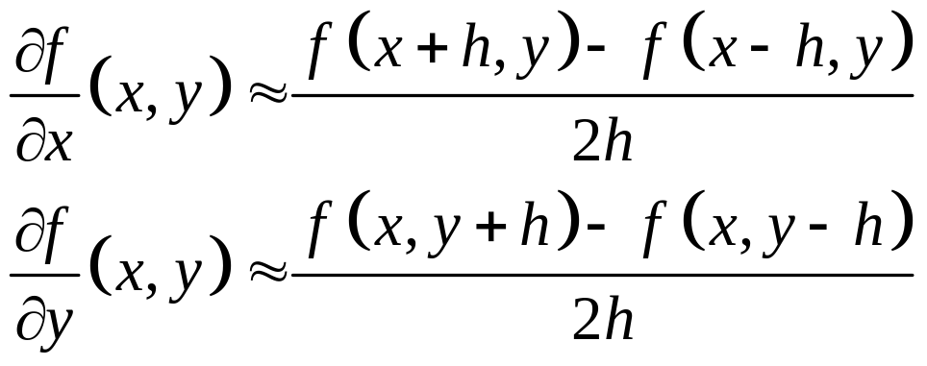
Partial Derivatives
Remember: Nothing special about partial derivatives:

Slide 36
THE END

